Slide 1
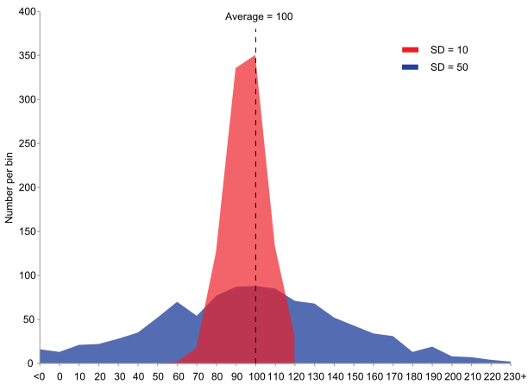
Standard deviation, skew, and variance
Geog4300/6300
Jerry Shannon

Slide 2
Central tendency doesn’t tell us everything…
Notes:
How are these different?

Slide 3
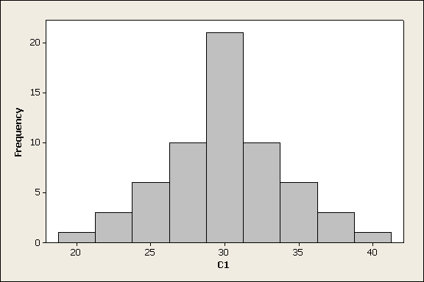
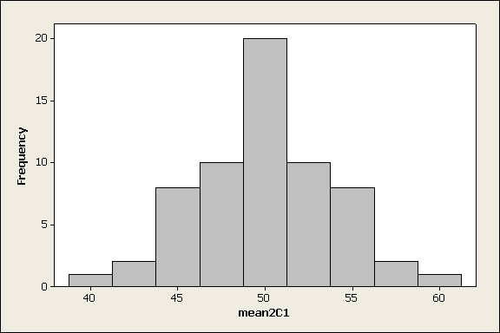
How do these compare?
Notes:
How are these different?

Slide 4
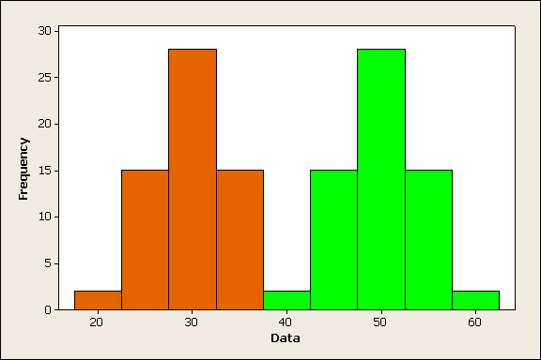
Notes:
Same distribution, differing means. Together would be a bi-modal distribution.

Slide 5
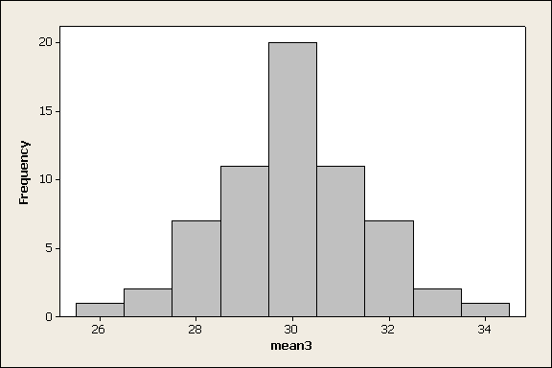
Now, how do these compare?
Notes:
Difference in spread--variation

Slide 6
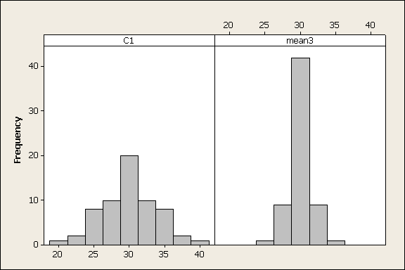
Using a similar range for x

Slide 7
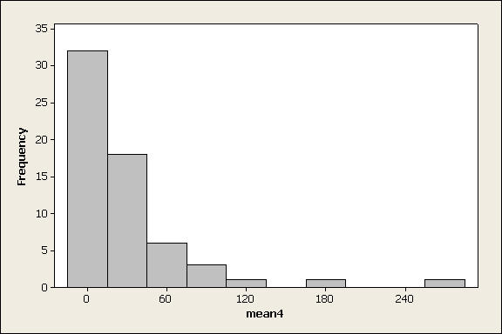
Differences in symmetry

Slide 8
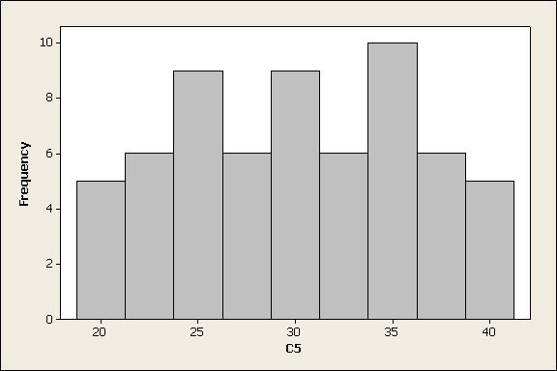
Differences in shape

Slide 9
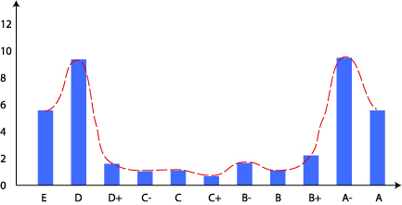
How many kinds of distributions are there??
Bi-modal
mode 1
mode 2
mean
median

Slide 10
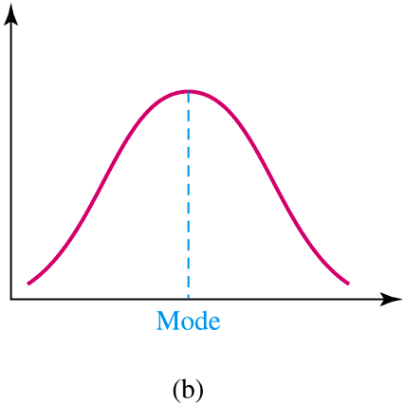
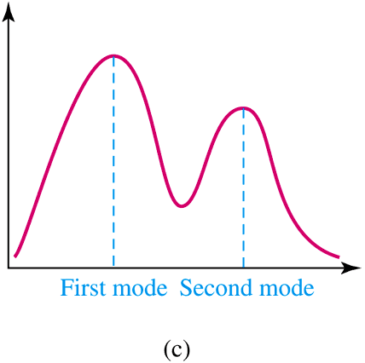
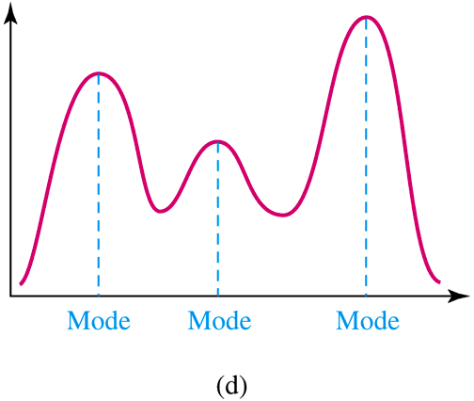
Many kinds of multimodal distributions

Slide 11
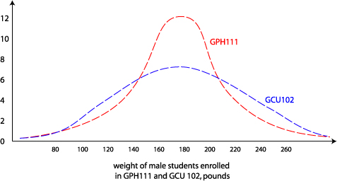
Shape of the dispersion
Not all normal distributions are created equal.

Slide 12
Dispersion
Two poker hands:
Full house: 4, 4, 4, 6, 6
Pair of eights: 2, 4, 8, 8, Q
Which has the greater dispersion?
How could we measure this?

Slide 13
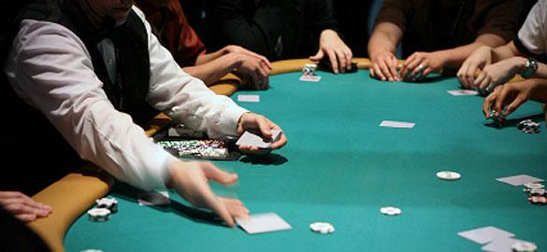
Could take the range
High value – low value
Full house: 6 -4= 2
Pair of 8s: Q (12) – 2 = 10

Slide 14
Could take the range
[High value] – [low value]
Full house: 6 -4= 2
Pair of 8s: Q (12) – 2 = 10
BUT…
large samples have greater ranges than small samples
this only measures two observations (ignoring many more)

Slide 15
How about the mean deviation?
Draw a five card poker hand from your deck. Find the mean.
Subtract the mean value from each of your cards (find the deviation)
Add up these deviations. Explain what you find.
Example:
A hand of 2, 5, 8, 8, and Q (12)
Mean value of (35/5) = 7
2 – 7 = -5, 5 - 7 = -2,…
Add -6 + -2 + …

Slide 16
How about the mean deviation?
A solution:
sum the absolute value of those deviations
then divide by n
Deviations
2 – 7= -5
5 – 7= -2
8 – 7= 1
8 – 7= 1
12 – 7= 5
Mean deviation
(5 + 2 + 1 + 1 + 5) / 5 = 2.8

Slide 17
The standard deviation
Fact: absolute values are hard to deal with algebraically. How else can we get all those deviations positive?
the standard deviation is the square root of the mean squared deviations…

Slide 18
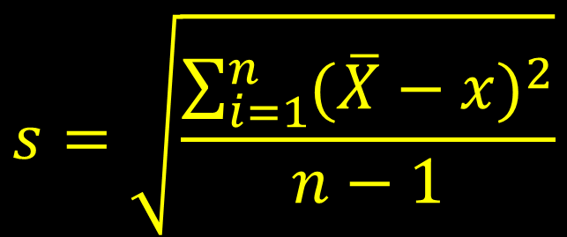
The standard deviation
Full house: 4, 4, 4, 6, 6
Mean: 4.8
Differences from mean:
-.8, -.8, -.8, 1.2, 1.2
$$s=\sqrt{\frac{\sum_{i=1}^{n}{{(\overline{X}−x)}^{2}}}{n−1}}$$
Square of differences:
.64, .64, .64, 1.44, 1.44
Sum of squares: 4.8
Sum divided by n-1 (4): 1.2
Square root (s.d.): 1.1

Slide 19
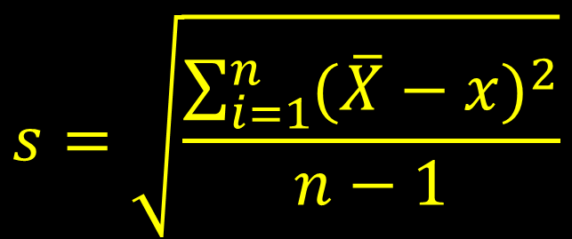
The standard deviation
Pair of eights: 2, 5, 8, 8, 12
Mean: 7
$$s=\sqrt{\frac{\sum_{i=1}^{n}{{(\overline{X}−x)}^{2}}}{n−1}}$$
Differences from mean:
-5, -2, 1, 1, 5
Square of differences:
25, 4, 1, 1, 25
Sum of squares: 56
Sum divided by n-1 (4): 14
S.D. of full house: 1.1
Square root (s.d.): 3.7

Slide 20
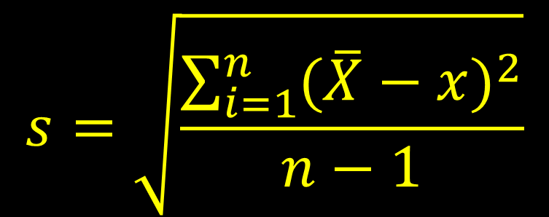
The standard deviation
Draw a hand from your poker deck
Calculate its standard deviation
$$s=\sqrt{\frac{\sum_{i=1}^{n}{{(\overline{X}−x)}^{2}}}{n−1}}$$
Statistical aside: the variance is the square of the standard deviation. It’s sometimes used in inferential statistics.

Slide 21
In R
Use the “sd” function
Draw 5 poker hands and enter each into r.
Hand1<-c(2, 5, 6, 2, 6)
Hand2<-c(5, 12, 7, 1, 9)
...
What are the mean and standard deviations?
Relevant functions are mean() and sd()

Slide 22
The standard deviation
Varies based on sample size and actual values:
ACT scores (10-36): sd of 5.2
SAT scores (900-2400): sd of 116
How can we compare them?

Slide 23
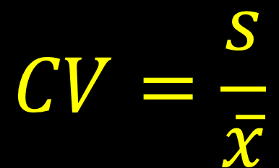
The coefficient of variation
Used to compare the spread of data sets with different means
ACT 2010
Average score: 21, SD: 5.2
$$CV=\frac{s}{\overline{x}}$$
SAT (Math) 2010
Average score: 516, SD: 116
Coefficient of Variation
ACT: .25, SAT: .23

Slide 24

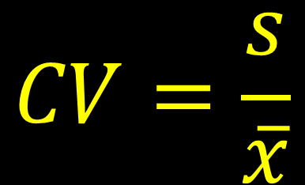
R challenge!
Load the Daymet data from lab 1 and calculate the mean, standard deviation, and cv for prcp by county (see q4 of lab 3). How does standard deviation compare to cv?
$$CV=\frac{s}{\overline{x}}$$

Slide 25
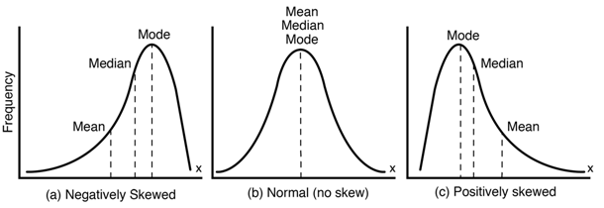
Skewed: Median ≠ mean
Link

Slide 26
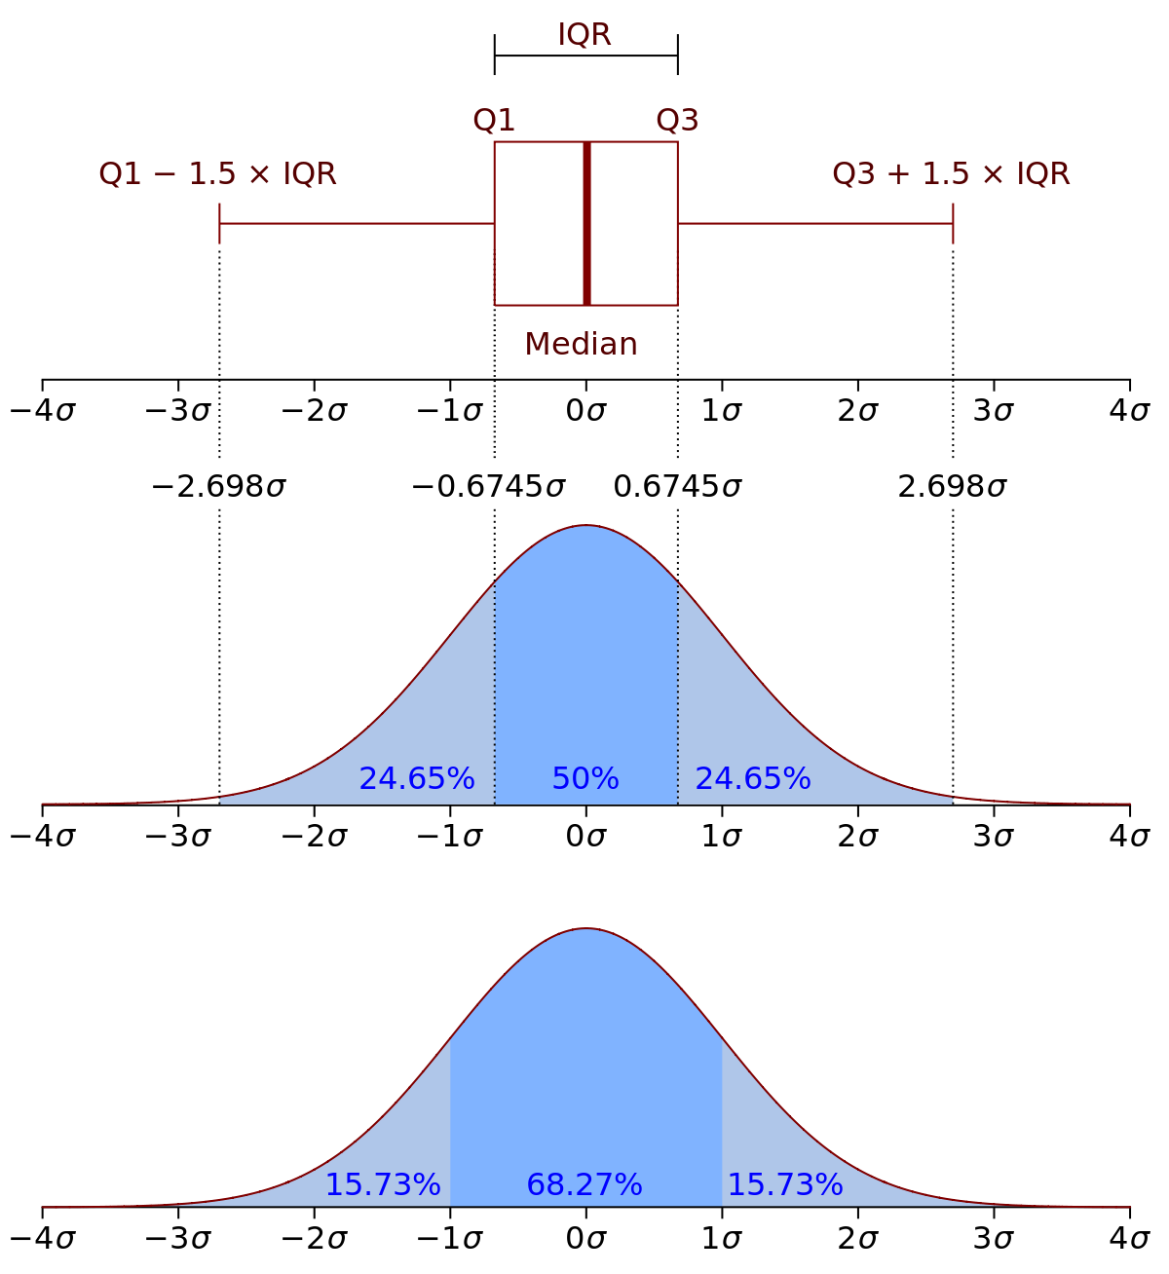
Interquartile range (IQR): Best for skewed data

Slide 27
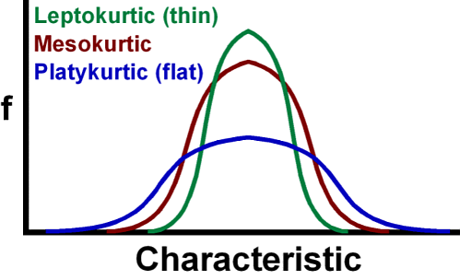
Kurtosis
How flat a distribution is
bogleheads.org

